Slide 1
Professional Ethics
Dr. Abhijit Mishra

Slide 2
Before we go into the details of Professional Ethics, let us first go through the definitions of each of terms i.e. ethics, profession, and professional ethics.
What is Ethics?
“ A branch of philosophy that involves systematizing, defending, and recommending concepts of right and wrong behavior.”

Slide 3
What is a profession?
“A vocation/job founded upon specialized high educational training, the purpose of which is to supply objective counsel and service to others, for a direct and definite compensation.”
What is professional ethics?
“It encompass the personal and corporate standards of behavior expected of professionals.”

Slide 4
What are the major elements of code of ethics for any profession?

Slide 5
HONESTY
A facet of moral character; denotes positive, virtuous attributes such as integrity, truthfulness in thought, action, and behavior; and straightforwardness along with the absence of lying, cheating, or theft.
INTEGRITY
Derived from Latin adjective ‘integer’ which means “wholeness”; unity of character; consistency in what you feel, think and act, consistency in public and private life, practicing what you preach; regarded as the opposite of hypocrisy.

Slide 6
TRANSPARENCY
A general quality; usually implemented by a set of policies, practices and procedures; it allows common people to have access, to use, utilize and understand information and processes held by centers of authority. (RTI & Social Audit are examples).
ACCOUNTABILITY
Answerability; blameworthiness; liability; the acknowledgment and assumption of responsibility for actions, products, decisions, and policies and be answerable for resulting consequences; cannot exist without proper accounting practices.

Slide 7
CONFIDENTIALITY
Keeping something secret or private; an ethical principle of discretion associated with the professions, such as medicine, law, psychotherapy. In law, and mediation, there exist communications between the client and the professional, which are “privileged” communications. (Current debate on AADHAR law).
OBJECTIVITY
Absence of bias/prejudice; impartiality, fairness, neutrality. (Media’s way of presenting news stories).

Slide 8
RESPECTFULNESS
Positive feeling/ deep admiration for something and someone as a result of his/her qualities; rude behavior towards someone indicates lack of respect; actions that honor somebody or something indicate respect; opposite of respect is contempt.
OBEDIENCE TO LAW
Law is a set of enforced rules which govern a society; one of the most basic and necessary social institutions; define rights/obligations of people and institutions and sets penalties for those who violate it; if not obeyed in letter and spirit, it might create chaos.

Slide 9
CONTRIBUTING TO THE PROFESSION’S PUBLIC IMAGE
It is also important for a professional to contribute towards building a positive image of their profession to the public; professional ethics/codes of conduct enable professionals to serve the public more effectively.
PROMOTING BUSINESS INTERESTS
facilitating morally feasible business dealings

Slide 10
What professional code of conduct should be followed by Electrical Engineers??

Slide 11
Institute of Electrical & Electronics Engineers (IEEE); Headquartered in New York City.
World’s largest technical professional society, with a world wide membership of more than 375,000 electrical, electronics, computer engineers, and computer scientists in approx. 60 countries.
IEEE has prepared a comprehensive Code of Ethics for its members; not binding for others; but indicates the broad ethical concerns which should be taken care of by electrical engineers.

Slide 12
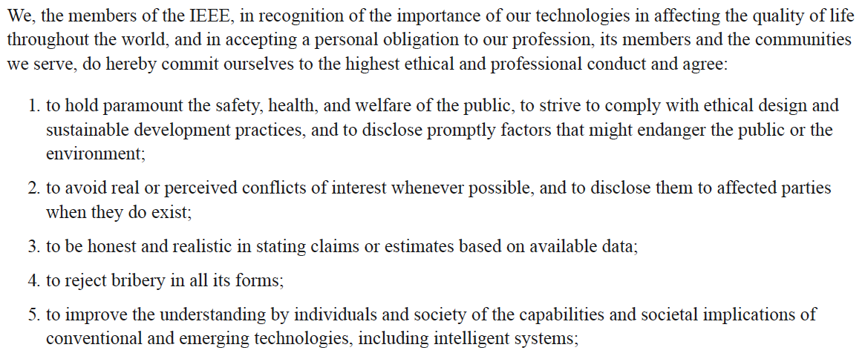
IEEE CODE OF ETHICS

Slide 13
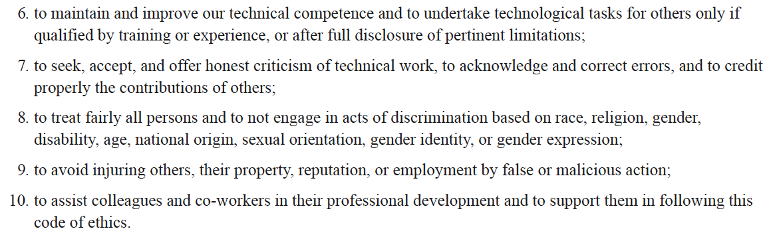
IEEE CODE OF ETHICS

Slide 14
Business/Corporate Ethics
Dr. Abhijit Mishra

Slide 15
Being a social endeavour/activity, business should not be conducted in a way detrimental to the interests of the society and the businesses itself.
Every profession or group frames certain do’s and do not’s for its members.
The members are given a standard in which they are supposed to operate.

Slide 16
These standards are influenced by the prevailing economic and social situations.
The term ‘Business Ethics’ refers to the system of moral principles and rules of the conduct applied to business.
The codes of conduct are periodically reviewed to suit the changing circumstances.

Slide 17
BUSINESS ETHICS: SOME DEFINITIONS
“Business Ethics is generally coming to know what is right or wrong in the work place and doing what is right. This is in regard to effects of products/services and in relationship with the stake holders.”
-Cater Mcnamara
“Business ethics in short can be defined as the systematic study of ethical matters pertaining to the business, industry or related activities, institutions and beliefs. Business ethics is the systematic handling of values in business and industry.”
—John Donaldson

Slide 18
Business ethics should take into consideration the following factors:
A business should aim to have fair dealing with everyone dealing with it.
Ethics should be fixed for everyone working in the organisation at any level and their implementation should be linked with reward-punishment system.
Any violation of ethics should be detected at the earliest and remedial measures taken immediately.
Business ethics should be based on broad guidelines of what should be done and what should be avoided.
The ethics should be based on the perception of what is right.

Slide 19
SOURCES OF BUSINESS ETHICS
In every society there are three sources of business ethics-
Religion
Culture and
Law
The HR manager in every organisation, thus, has to be well versed with the unique system of values developed by these three sources.

Slide 20
RELIGION
Religion:
Oldest source of ethical inspiration; thousands of religions having divergent views about various things; nearly all of them agree on certain fundamental principles. Every religion gives an expression of what is wrong and right in various walks of life. The Principle of reciprocity towards one’s fellow beings is found in all the religions. Great religions preach the necessity for an orderly social system and emphasize upon social responsibility with an objective to contribute to the general welfare. With these fundamentals, every religion creates its own code of conduct.

Slide 21
RELIGION
Culture:
It is the set of important understandings that members of a community share in common. It consists of a basic set of values, ideas, perceptions, preferences, concept of morality, code of conduct etc. which creates distinctiveness among human groups. Culture differs from society to society. Moreover culture is passed from generation to generation. Culture facilitates the generation of commitment to something larger than one’s individual self interest.

Slide 22
RELIGION
Law:
The legal system of any country, guide the human behaviour in the society. Whatever, ethics the law defines are binding on the society. The society expects the business to abide by the law. Although it is expected that every business should be law abiding, seldom do the businesses adhere to the rules and regulations. Law breaking in business is common eg. Tax evasion, hoarding, adulteration, poor quality & high priced products, environment pollution etc.

Slide 23
What is the importance of business/corporate ethics??

Slide 24
Corresponds to Basic Human Needs:
Membership of various groups provide us a basis of our identity. Therefore, it becomes a fundamental need of a human being.
We all want to be part of an organisation which we can respect and be proud of, because they are known to be ethical.
Everybody likes to be associated with an organisation which the society respects as a honest and socially responsible organisation.
The HR managers have to fulfil this basic need of the employees as well as their own basic need that they want to direct an ethical organisation. The basic needs of the employees as well as the managers compel the organizations to be ethically oriented.

Slide 25
Credibility in the Public:
Ethical values of an organisation create credibility in the public eye.
People will like to buy the product of a company if they believe that the company is honest and is offering value for money.
The public issues of such companies are bound to be a success. Because of this reason only the cola companies are spending huge sums of money on the advertisements now-a-days to convince the public that their products are safe and free from pesticides of any kind.

Slide 26
Credibility with the Employees:
When employees are convinced of the ethical values of the organisation they are working for, they hold the organisation in high esteem.
It creates common goals, values and language. The HR manager will have credibility with the employees just because the organisation has credibility in the eyes of the public.
Perceived social uprightness and moral values can win the employees more than any other incentive plans.

Slide 27
Better Decision Making:
Respect for ethics will force a management to take various economic, social and ethical aspects into consideration while taking the decisions. Decision making will be better if the decisions are in the interest of the public, employees and company’s own long term good.

Slide 28
Profitability:
Being ethical does not mean not making any profits.
Every organisation has a responsibility towards itself also i.e., to earn profits.
Ethical companies are bound to be successful and more profitable in the long run though in the short run they can lose money.

Slide 29
Protection of Society:
Ethics can protect the society in a better way than even the legal system of the country.
Where law fails, ethics always succeed. The government cannot regulate all the activities that are harmful to the society.
A HR manager, who is ethically sound, can reach out to agitated employees, more effectively than the police.

Slide 30
Corporate Social Responsibility
“CSR analyses economic, legal, moral, social and physical aspects of environment.”
- Barnard (1938)

Slide 31
CSR- a concept which has become dominant in current day business reporting.
It is relatively new thing for Indian businesses.
The concept of CSR rests on the ideology of give and take.
Corporations take resources from the society in form of raw materials, human resource etc.
By engaging in CSR activities, they try to give back to the society.

Slide 32
The broadest definition of CSR is concerned with the question- what is or should be the relationship between global corporations, government of countries and individual citizens.
CSR has also been defined by European Union Commission (2002) as
“ CSR is a concept whereby companies integrate social and environmental concerns in their business operations and in their interaction with their stakeholders on a voluntary basis.”

Slide 33
It has now been established that activities of an organization have an impact on the environment.
In 1970s for the first time, an idea came up that the organizations, in their annual disclosures (reports, accounts), should also report the impact of their activities on the society and environment at large.
This idea gained momentum in the coming years and has now become an important part of business reporting.
Though the question of social obligation/ performance of a business still generates extensive debate, the importance of CSR activities is now established.

Slide 34
HOW CORPORATIONS AFFECT SOCIETY
Any activity that an organization undertakes will have effect not just upon itself but also on the environment (physical/socio-economic) in which it operates.
While evaluating the effect of an organization on its external environment, following should be included-
the business environment in which the firm operates
the local societal environment
the wider global environment

Slide 35
HOW CORPORATIONS AFFECT SOCIETY
Effect of organizations can take many forms: -
Utilization of natural resources as a part of its production process;
Effects of competition between that organization and other organization in the same market;
Enrichment of local community through creation of employment opportunities;

Slide 36
HOW CORPORATIONS AFFECT SOCIETY
Transformation of landscape due to raw material extraction or waste product storage.
Distribution of wealth created within the firm to the owners and workers and its impact on welfare of individuals.
Climate change/ Carbon footprint/ Greenhouse gas emissions
From the above, it is clear that organizations can have significant impact on physical, social, economic environment both locally and globally.

Slide 37
PRINCIPLES OF CSR
There are three basic principles that govern CSR activities in general: -
Sustainability
Accountability
Transparency

Slide 38
SUSTAINABILITY
“ The world has enough for everyone’s need, but not enough for everyone’s greed.”
(Mahatma Gandhi)
This idea cautions us to be judicious in utilizing the natural resources.
The principle of sustainability is concerned with the impact of current activities on the options available in future.

Slide 39
SUSTAINABILITY
If resources are finite in quantity, and they are exploited extensively at present, they might not be available to our future generations.
The current debate on energy efficiency and renewable energy resources is an example of this principle.

Slide 40
ACCOUNTABILITY
Accepting and recognizing your responsibility for the effects of your activities.
It involves quantification and reporting of actions taken by an organization (externally and internally) to all parties affected by those actions.
Such reporting should be understandable and relevant to all concerned as well as reliable and accurate.

Slide 41
TRANSPARENCY
It means that the external impact of activities of an organization can be judged from its reports, data and statistics and nothing is disguised in their reporting.
It means that the effects of the activities of an organization should be apparent to all from using the information provided by organization’s reporting mechanisms.

Slide 42
CSR in INDIA
In 2013, Govt. of India made several amendments to the Companies Act which also included provision of CSR.
According to the amended Companies Act (2013), all companies, Indian or branches/associates of foreign commercial entities operating in India, with net worth of Rs. 500 crore and above; having annual turnover of Rs. 1000 crore and above; and net profit of Rs. 5 crore or more are liable to spend 2 % of average net profit on CSR activities.
Provisions effective from 01.04.2014.

Slide 43
CSR in INDIA
Activities covered under CSR in India include: -
eradicating extreme hunger and poverty;
promotion of education;
promoting gender equality and empowering women;
reducing child mortality and improving maternal health;
combating human immunodeficiency virus, acquired, immune deficiency syndrome, malaria and other diseases;

Slide 44
CSR in INDIA
ensuring environmental sustainability;
employment enhancing vocational skills;
social business projects;
contribution to the Prime Minister's National Relief Fund or any other fund set up by the Central Government or the State Governments for socio-economic development and relief and funds for the welfare of the Scheduled Castes, the Scheduled Tribes, other backward classes, minorities and women and such other matters as may be prescribed.

Slide 45
Approaches to Moral Decision Making
Dr. Abhijit Mishra

Slide 46
RIGHTS APPROACH
Originated from the Philosophy of Immanuel Kant.
Proponents of this approach believe that human beings are different from objects in the sense that people have dignity based on their ability to choose freely what they will do with their lives, and they have a fundamental moral right to have these choices respected.
Rights approach believes that an action or policy is morally right only if those persons affected by the decision are not used merely as instruments for advancing some goal, but are fully informed and treated only as they have freely and knowingly consented to be treated.

Slide 47
RIGHTS APPROACH
It implies that each person has a fundamental right to be respected and treated as a free and equal rational person capable of making his or her own decisions.
In deciding whether an action is moral or immoral using this approach, then, we must ask, Does the action respect the moral rights of everyone?
Actions are wrong to the extent that they violate the rights of individuals; the more serious the violation, the more wrongful the action.

Slide 48
UTILITARIAN APPROACH
Originated from the the philosophy of Jeremy Bentham and John Stuart Mill.
They believed that ethical actions are those that provide the greatest balance of good over evil.
To analyse an issue using the utilitarian approach, we first identify the various courses of action available to us.
Second, we ask who will be affected by each action and what benefits or harms will be derived from each.
And third, we choose the action that will produce the greatest benefits and the least harm.

Slide 49
UTILITARIAN APPROACH
Focuses on the consequences that actions or policies have on the well-being ("utility") of all persons reasonably foreseen to be directly or indirectly (but rather immediately) affected by the action or policy.
The principle states: "Of any two actions, the most ethical one will produce the greatest balance of benefits over harms."

Slide 50
VIRTUE APPROACH
The virtue approach to morality assumes that there are certain ideals toward which we should strive.
These ideals provide for the full development of our humanity, and are discovered through thoughtful reflection on what kind of people we have the potential to become.
In dealing with an ethical problem using the virtue approach, we might ask, What kind of person should I be? What will promote the development of character within myself? within my community? etc.

Slide 51
VIRTUE APPROACH
Focuses on attitudes, dispositions, or character traits that enable us to be and to act in ways that develop our human potential.
The principle states: "What is ethical is what develops moral virtues in ourselves and our communities."

Slide 52
FAIRNESS APPROACH
Rooted in the philosophy of Greek philosopher Aristotle.
Aristotle believed that "equals should be treated equally and unequals unequally."
The basic moral question in this approach is: How fair is an action? Does it treat everyone in the same way, or does it show favoritism and discrimination?

Slide 53
FAIRNESS APPROACH
Focuses on how fairly or unfairly our actions distribute benefits and burdens among the members of a group.
Fairness requires consistency in the way people are treated.
The principle states: "Treat people the same unless there are morally relevant differences between them."

Slide 54
COMMON GOOD APPROACH
Originated from the thoughts of Aristotle, Plato and Cicero.
This approach believes in a society comprising individuals whose own good is inextricably linked to the good of the community. Community members are bound by the pursuit of common values and goals.
This approach focuses on ensuring that the social policies, social systems, institutions, and environments on which we depend are beneficial to all.

Slide 55
COMMON GOOD APPROACH
Presents a vision of society as a community whose members are joined in a shared pursuit of values and goals they hold in common.
The community is comprised of individuals whose own good is inextricably bound to the good of the whole.
The principle states: "What is ethical is what advances the common good."

Slide 56
Theistic & Atheistic Approaches to Ethics
Dr. Abhijit Mishra

Slide 57
Atheism and Theism both deal with religion and the existence of God.
The primary difference them is that theism is the belief in the existence of God, whereas Atheism is the belief in the non-existence of God.
It is notable that all religions have one thing in common- they all believe in the existence of God who may be singular, as in Christianity or Islam, or multiple as in Hinduism.

Slide 58
The contrast to the existence of God, is the belief that there is no, i.e. no God, benevolent or otherwise exists. This is Atheism. Atheism believes that there is no God or gods, and god certainly did not create the universe, nor does he actively take part in it.
The term theism comes from the Greek word, ‘theos’ which means "god". Atheism comes from the Greek word ‘atheos’, which means "without god(s)". Atheism literally just adds a- in front of theism. The prefix a- in Greek means without; hence atheism or ‘atheos’ means without God.

Slide 59
There are many variations or levels of believe in atheism and theism. There are people who claim that they believe in God but not in religion, people who claim that they would like to believe in God, and various other belief systems.
People often tend to mistake atheism as a religion itself or as a group. However, that is not the case. Atheism is a belief model and nothing more. Some people also claim that atheism is against religion and/or God, which is again not the case. It is only a matter of personal belief.

Slide 60
DIFFERENCE BETWEEN THEISM & ATHEISM
 | Atheism | Theism
Definition | Disbelief or lack of belief in the existence of God or gods. | Belief in the existence of a god or gods, specifically of a creator who intervenes in the universe.
Description | Atheism is the belief that there is no God; that no God exists; and no God created the universe. | Theism is the belief that there is a God; that God exists; and that the God created the universe and still intervenes in it.
Belief | Belief that God does not exist | God does exist and influences the world

